Slide 1
Assignment 3 & 4: Charts
DSC640-T301 Data Presentation and Visualization
Date:1/2/2023
By: Joshua Greenert

Slide 2
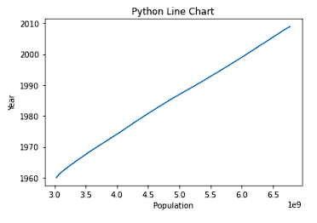
Python Charts

Slide 3
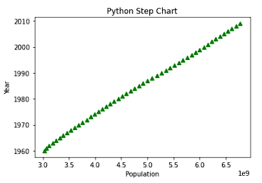
Python Charts

Slide 4
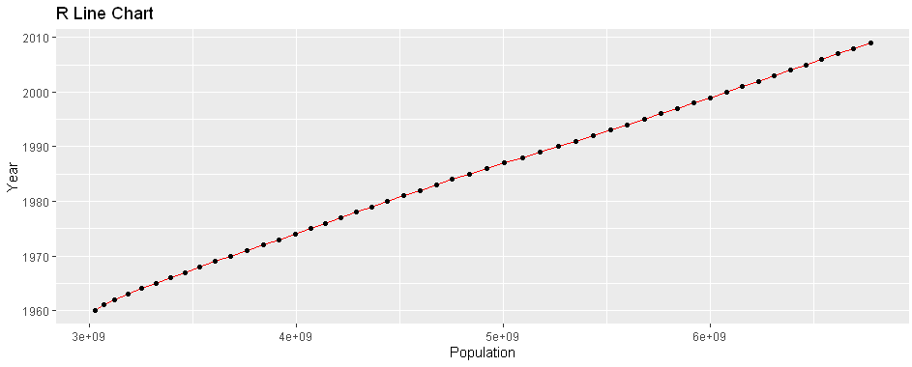
R Charts

Slide 5
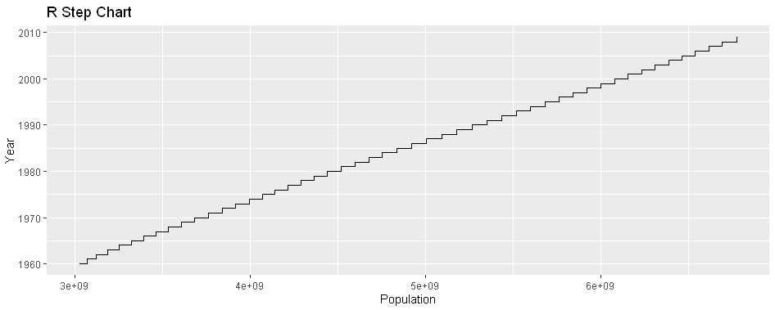
R Charts

Slide 6
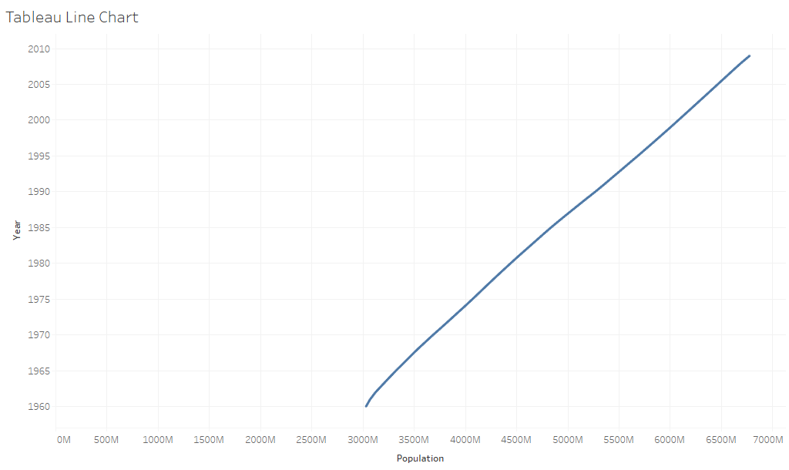
Tableau Charts

Slide 7
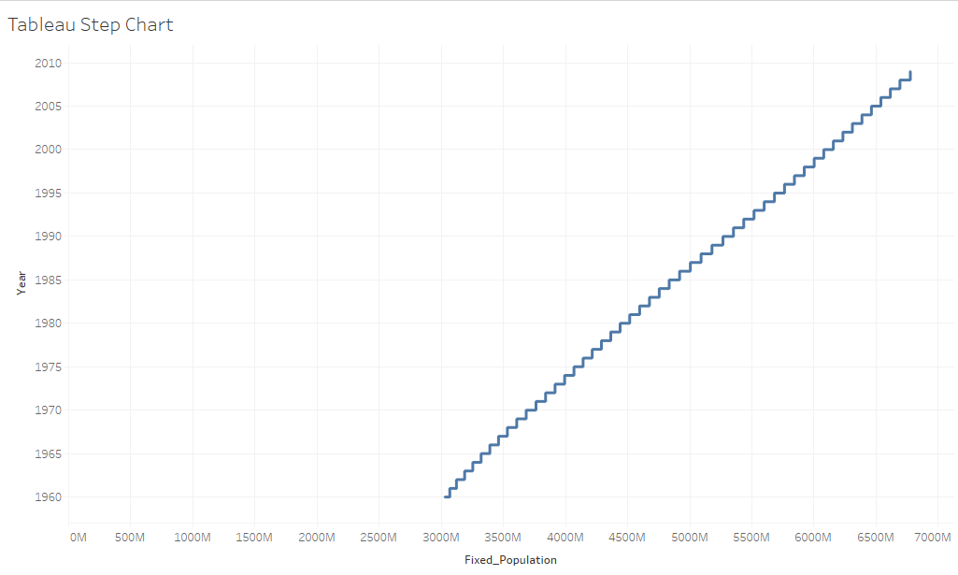
Tableau Charts

